Slide 1
Project Title: Cost savings from procurement of sub-component part instead of whole assembly
Charter Template
Business Case/objectives:
This project aims at coding sub component parts used to revamp materials against outright procurement of the complete unit.
All control valves and shutdown valves in the plant use positioners for feedback status. The main components of the positioners are the power module, communication module, relays and I/P converter. Common failure mode of the positioners are power module and communication module failure. We have about 5 positioners we can revamp when we code and procure these sub component parts giving us a cost savings of $ 11,935.58 k.
Material details:
3pcs 1002208542 TERMINAL BOX ASSY,GE44081X012,FISH-CO @$706.73 =$2,120.19
3pcs 1002208541 PRINTED WIRING BOARD ASSY,GE040+,FISH-CO @$3,508.83 =$10,526.49
2pcs 1002208540 TERMINAL BOX ASSY,19B5401X072,FISH-CO @$636.66 @$1,273.32
2pcs 1002208539 PRINTED WIRING BOARD ASSY,48B77+,FISH-CO @$2,750.01 =$5,500.02
Total cost of replacement parts: $19,420.02 Vs total cost of 5 complete positioners: $31,355.6 gives a total cost savings: $11,935.58
Potential Benefits & Measurement:
Cost savings of approx. 12k in coding of sub component (BOM)
Asset availability and reduction in downtime of equipment associated with switch failure
Project Scope/Actions :
Obtain material details and code material no for SAP
Secure BFM approval and follow up PO creation
Delivery of materials
Revamp of 5nos valve positioner
Critical Success Factors:
C&P procurement processes
High-level Timeline:
L0-L1: 30 July 2018
L2: 6 August 2018
L3: 30 August 2018
L4: 15 September2018
L5: 20 September 2018
Initiative End
Project sponsor: Onyeka IKE
Team members:
Obioha Obinna
Gelor Agberhia

Slide 2
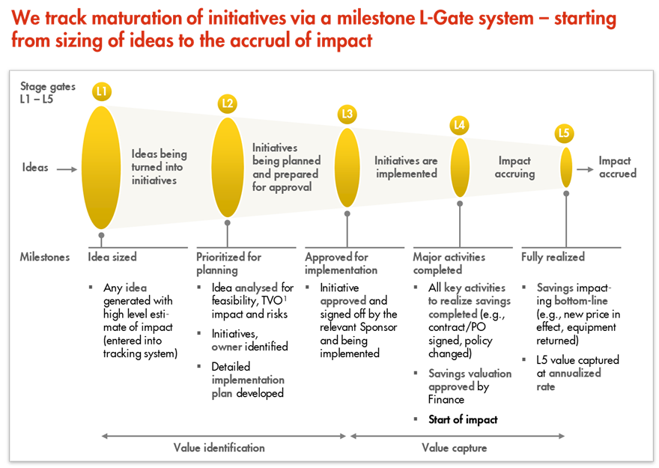
L1 – L5 Gates

